Slide 1

Using Version Control in Statistics Education
Craig Alexander
craig.alexander.2@glasgow.ac.uk

Slide 2

Introduction - Why Version Control in statistics education?
Many degree programmes in Statistics consist of courses with a high volume of theory, lacking exposure to technical skills key for the workplace.
It is important that we equip our graduates with such skills, so they are prepared for the job market.
Version control is becoming an ever-increasing feature within roles across academia and industry in statistics and data science.
How do we integrate teaching version control into our learning and teaching practice?

Slide 3
Introduction – Incorporating Version Control into Teaching
To help integrate version control knowledge into our teaching practices, we have:
Created a short Version Control course
Developed by David McArthur, Andrew Elliott, Craig Alexander & Vinny Davies.
Designed for use for UG/PG students, PG researchers & staff.
Designed assessment strategies using Version Control
Promoting use within group-based assessments.
Incorporating short course notes, promoting a flipped classroom strategy.

Slide 4

Developing a Version Control Course – Case Study
An ‘Innovation in Teaching’ project to develop short course on version control as part of the school’s AI3 Initiative².
Comprised of seven units building from basics to advanced concepts.
Tailored exercises which can be used for stand-alone learning or as part of a course.
Course notes use bespoke accessible features as discussed in Jack et al. (2023)³.
2. https://www.gla.ac.uk/schools/mathematicsstatistics/research/stats/teaching/versioncontrolforteachingandresearch/
3. Jack, E., Alexander, C., McArthur, D. and Mair, C. (2023) Reflections on designing and delivering an online distance learning programme in the mathematical sciences. MSOR Connections, 21(2), pp. 25-33. (doi: 10.21100/msor.v21i2.1397)

Slide 5
Developing a version control course – Considerations
When designing the course, several considerations had to be made.
There are an abundance of online resources for using version control – aim is to create a tailored course for statistics and data science.
Users have different areas of expertise – need a course which covers multiple usage scenarios.
For example, UG students and PG researchers will have different levels of exposure to programming and project-based work – course content & structure should reflect this.

Slide 6
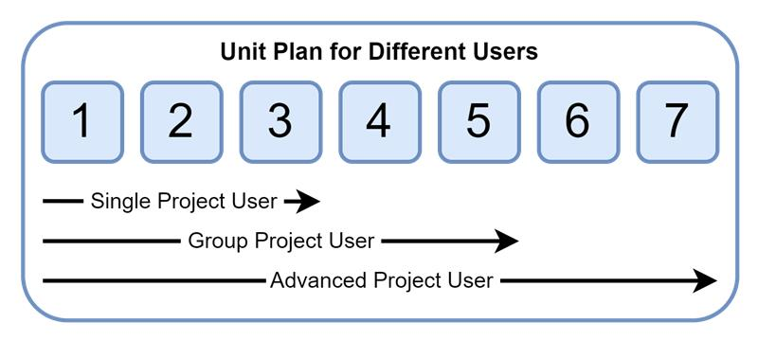
Considerations – Example Structure
Learners will all have different desired outcomes in terms of what they would like to get out of the course.
Course has been designed in structured units to meet the needs for each users' requirements.

Slide 7
Developing a Version Control Course – Course Structure
Unit 1 – Up and Running
Unit 2 – Basic workflow for single user
Unit 3 – Consuming & contributing to open-source projects
Unit 4 – Solid foundations for users
Unit 5 – Branching and branching strategies
Unit 6 – Using GitHub Flow in a team
Unit 7 – Foundations for advanced users

Slide 8
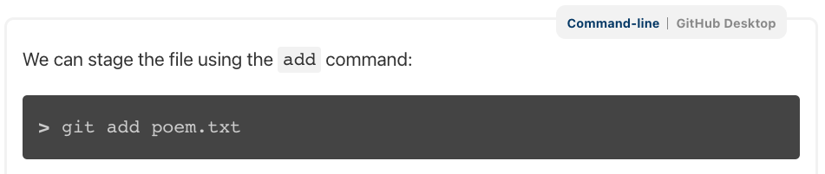
Considerations – Command line vs. GitHub Desktop
Git commands can be carried out using command line operations or via a GUI such as GitHub Desktop.
To cater to the different needs of users, the notes include examples for both command line and GitHub Desktop use.
We have provided details on using either format for the full course, providing a “switcher” within the notes to allow users to choose their preference.

Slide 9
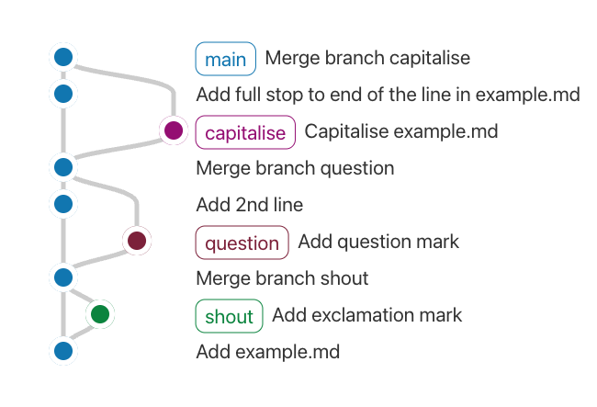
Considerations – Visualising Branches
To illustrate the concepts behind git and GitHub, we have included a graphical visualisation of a repository using gitgraph⁴.
This allows us to give a graphical representation of a repository workflow and are particularly useful when discussing branching.
4. https://github.com/nicoespeon/gitgraph.js/

Slide 10
Course Plans
This academic year, we intend to release the course as a resource across the school:
Semester 2 MSc (on-campus) course on data analysis skills
ODL MSc final project students
Staff/PhD students – 1h presentation and course release
Feedback from these cohorts will be used to further develop the course and investigate scholarship activities into good practice using version control.

Slide 11
Using Version Control in Assessment – Case Study
Semester 2 MSc Data Analysis Skills course – focus on graduate attributes for careers in statistics and data science.
Version control covered for 2 weeks of the course, using short course delivered in a flipped classroom format.
Group project using version control for data analysis
Groups create repository for R/Python analysis
Promoting working in a collaborative environment
Assessment focus on general good practice, successful use of pull requests and code review.

Slide 12
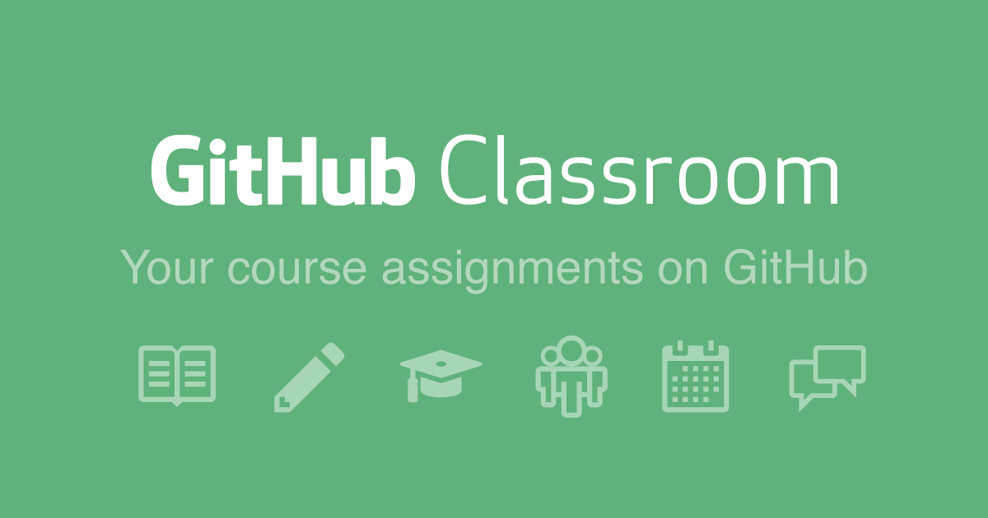
Using Version Control in Assessment – Case Study
Student feedback very positive on using version control.
Enjoy practical exposure to group-based projects.
This year:
Use new course materials.
Extra week of GitHub in labs.
Use GitHub Classroom⁵ to assist with administrative processes.
5. https://classroom.github.com/

Slide 13



Thank you! Any questions?
#UofGWorldChangers
@UofGlasgow

